Slide 1
Hematovision Advance Blood Cell Classification Using Transfer Learning
SlideMake.com

Slide 2

Introduction to Hematovision and Blood Cell Classification
Hematovision is an advanced system designed for accurate blood cell analysis and classification.
Automated classification of blood cells is crucial for diagnosing various hematological disorders.
Transfer learning offers a promising approach to enhance classification accuracy with limited labeled data.
Notes:
Image source: https://www.slidemake.com

Slide 3
Importance of Blood Cell Classification
Accurate blood cell classification aids in diagnosing diseases such as leukemia, anemia, and infections.
Manual microscopy is time-consuming and subject to human error, highlighting the need for automation.
Machine learning-based systems can provide rapid and reliable analysis for clinical decision-making.
Notes:
Image source: https://www.slidemake.com

Slide 4
Challenges in Blood Cell Classification
Variability in cell appearance due to staining, lighting, and image quality complicates classification.
Traditional machine learning models require extensive labeled datasets, which are often scarce.
Differentiating between similar cell types, such as different white blood cells, remains difficult.
Notes:
Image source: https://www.slidemake.com

Slide 5
Overview of Transfer Learning
Transfer learning involves leveraging pre-trained models on large datasets to improve new task performance.
It reduces the need for extensive labeled data and accelerates the training process.
Common architectures used in transfer learning include ResNet, VGG, and DenseNet.
Notes:
Image source: https://www.slidemake.com

Slide 6
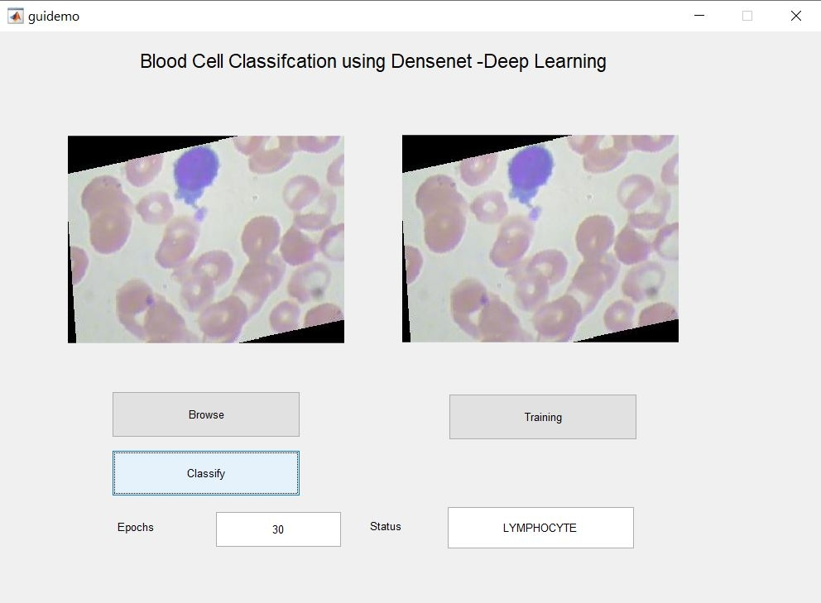
Hematovision System Architecture
The system integrates high-resolution blood smear imaging with deep learning models for classification.
Transfer learning models are fine-tuned on blood cell images to adapt to specific features.
The architecture includes feature extraction layers, followed by classification layers customized for blood cell types.
Notes:
Image source: https://www.pantechsolutions.net

Slide 7
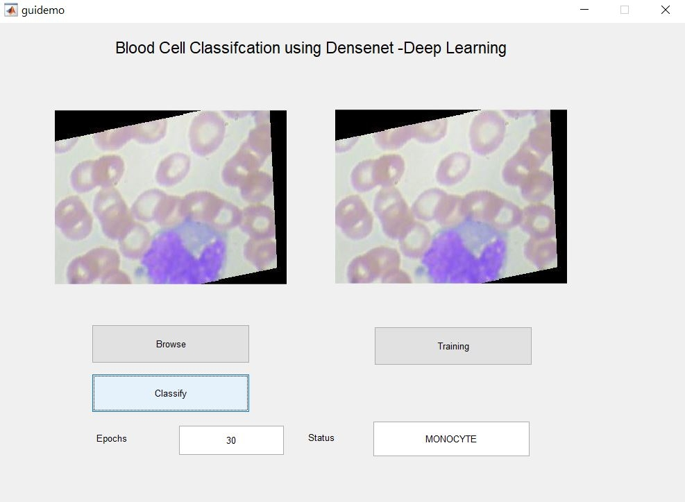
Data Collection and Preprocessing
Blood smear images are collected from clinical samples and annotated by expert hematologists.
Data augmentation techniques, such as rotation and scaling, are used to enhance model robustness.
Preprocessing steps include normalization and segmentation to isolate individual cells for analysis.
Notes:
Image source: https://www.pantechsolutions.net

Slide 8

Implementation of Transfer Learning
Pre-trained models like ResNet50 are adapted by replacing the final layers with blood cell-specific classifiers.
The models are fine-tuned using labeled blood cell images to improve classification accuracy.
Training involves optimizing hyperparameters and employing techniques like early stopping to prevent overfitting.
Notes:
Image source: https://gopichandrakesan.com

Slide 9
Results and Performance Evaluation
The transfer learning approach achieved higher accuracy compared to traditional machine learning methods.
Metrics such as precision, recall, F1-score, and confusion matrices demonstrate the system's effectiveness.
The system showed robustness across different cell types and image qualities.
Notes:
Image source: https://www.pantechsolutions.net

Slide 10
Future Directions and Clinical Impact
Integration with real-time diagnostic tools can facilitate rapid blood analysis in clinical settings.
Further research aims to expand the dataset and include rare blood cell types for comprehensive classification.
Automated blood cell classification can significantly improve diagnostic speed and accuracy in healthcare.
Notes:
Image source: https://www.slidemake.com

Slide 11
References
[Insert relevant references here, such as key papers on Hematovision, transfer learning, and blood cell classification]
Your second bullet
Your third bullet

